Slide 1











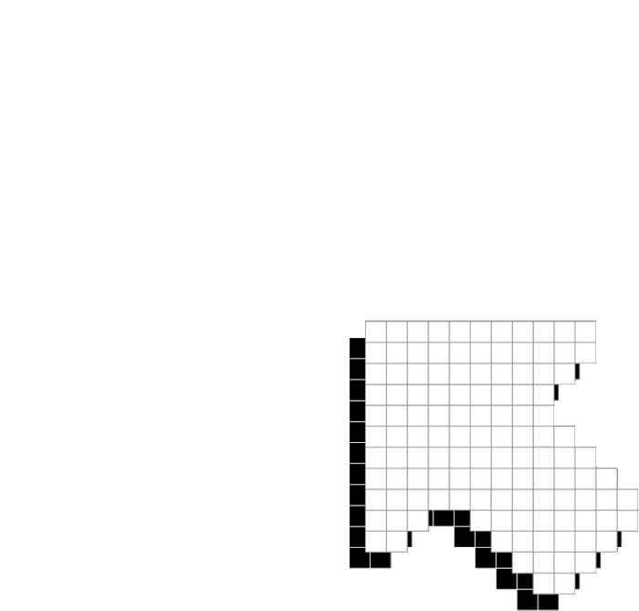



PLAYER 1
HIGHSCORE 2500
PLAYER 2
WHACK-A-MOLE
GAME
EC 311 Final Project
Boston University Fall 2023
No Name Group

Slide 2
















01
07
12
MEMBERS
CHOOSE YOUR PLAYER
Arnav Pratap Chaudhry
Pree
simpliphan
Rawisara
chairat
Vansh
Bhatia

Slide 3



01
07
12
GOAL AND MOTIVATION
Develop an entertaining
“WHACK-A-mole” game on a vga
display with mouse controls
Merge the classic appeal of
Whack-a-Mole with modern technology
LET’S WHACK A MOLE!
Expanding on the existing FPGA
Whack-a-Mole game, our project
integrates this code onto the VGA
screen for an Interactive experience

Slide 4
01
07
12
FUNCTIONALITY
INPUTS
SCORING
DIFFICULTY
Using mouse tracking to ensure that the user is on the mole
The user gets +3 points every time they whack a mole sucessfully
To increase the difficulty, we increase the number of moles
the user gets 3 more poinTs by moving on to the next level
As levels increase, the frequency of moles appeaRing also increases
tracking mouse click to “whack” the mole

Slide 5















SPECIFICATIONS: REQUIREMENTS AND CONSTRAINTS

Slide 6


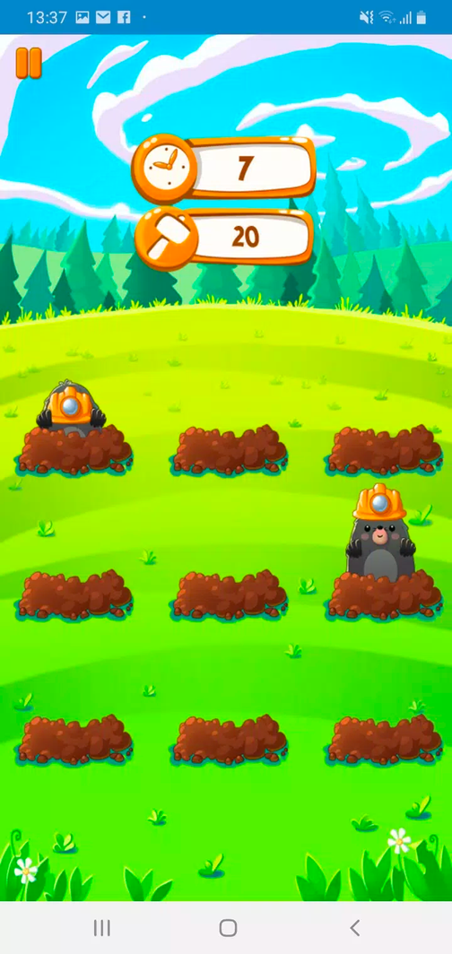
CONSTRAINTS
GAME LOGIC:
Mole character generation
timing
scoring
difficulty
timing constraints
Minimize latency for smooth operation
Accurate timing for VGA signal generation
USER INTERFACE
MEMORY
mouse to whack the moles
Sprite storage
Restoring the frames for mole position, end game
VGA DISPLAY
REALtIME SCORE DISPLAY
STANDARD resolution
(640 x 480 pixels)
smooth frame rate (30fps)
distinct colours for mole,background,score etc.
INterface Responsiveness
Debouncing input keys to ensure instanatneous and accurate user’s action

Slide 7

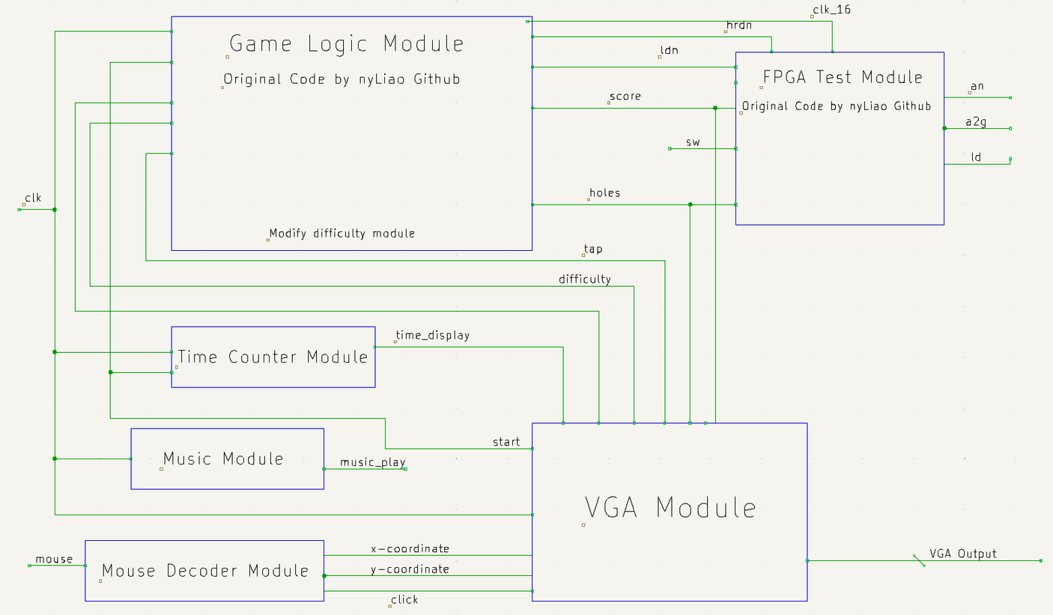
HIGHSCORE 2500
BLOCK DIAGRAM
BLOCK DIAGRAM
Old module: GAME LOGIC, CLOCK MODULE (inside game logic),
FPGA TEST MODULE
NEW module: Time Module, Mouse Module, VGA Module, MUSIC Module
Modified module: Difficulty module
link to the original code

Slide 8
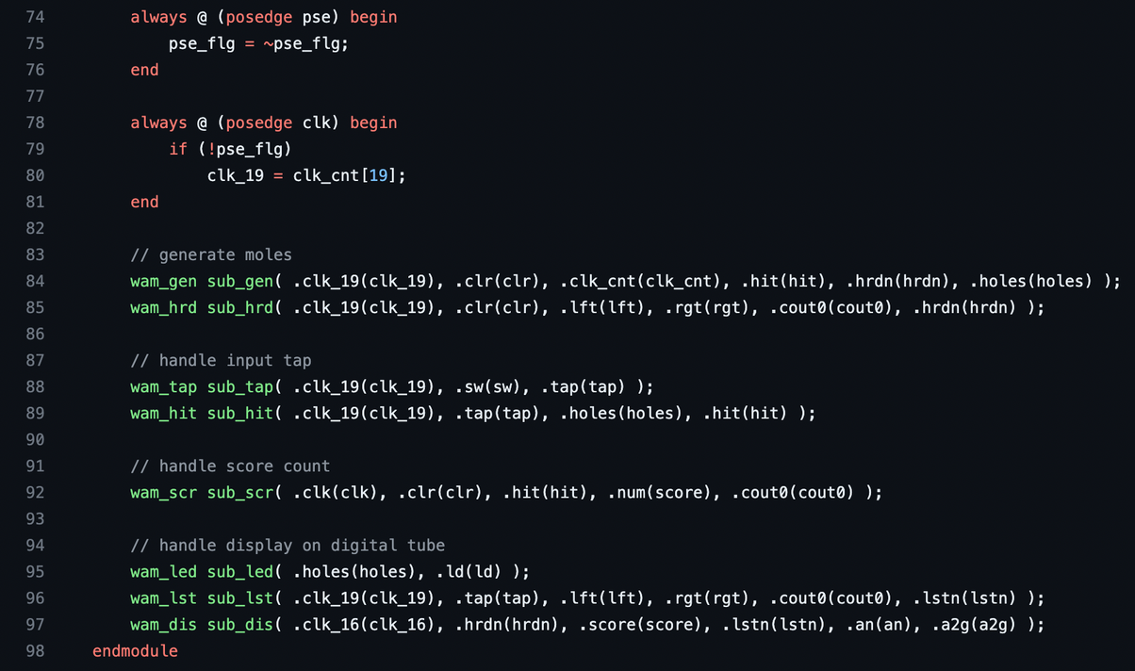
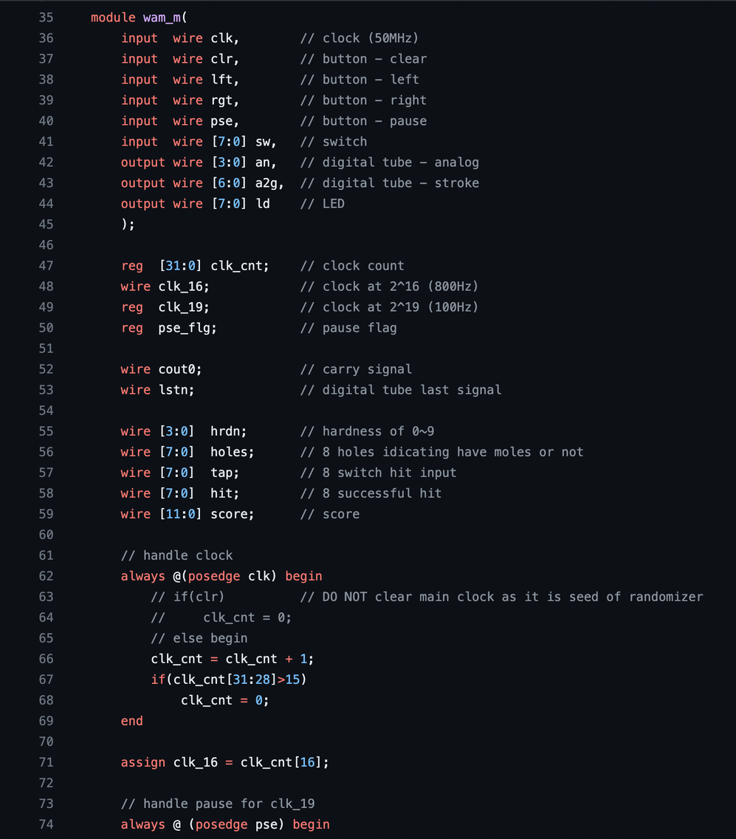

GAME LOGIC FROM SOURCE CODE
Game Logic to generate moles and check if we scored or not
FPGA TEST
Main modules from https://github.com/nyLiao/Whac-A-Mole-FPGA

Slide 9
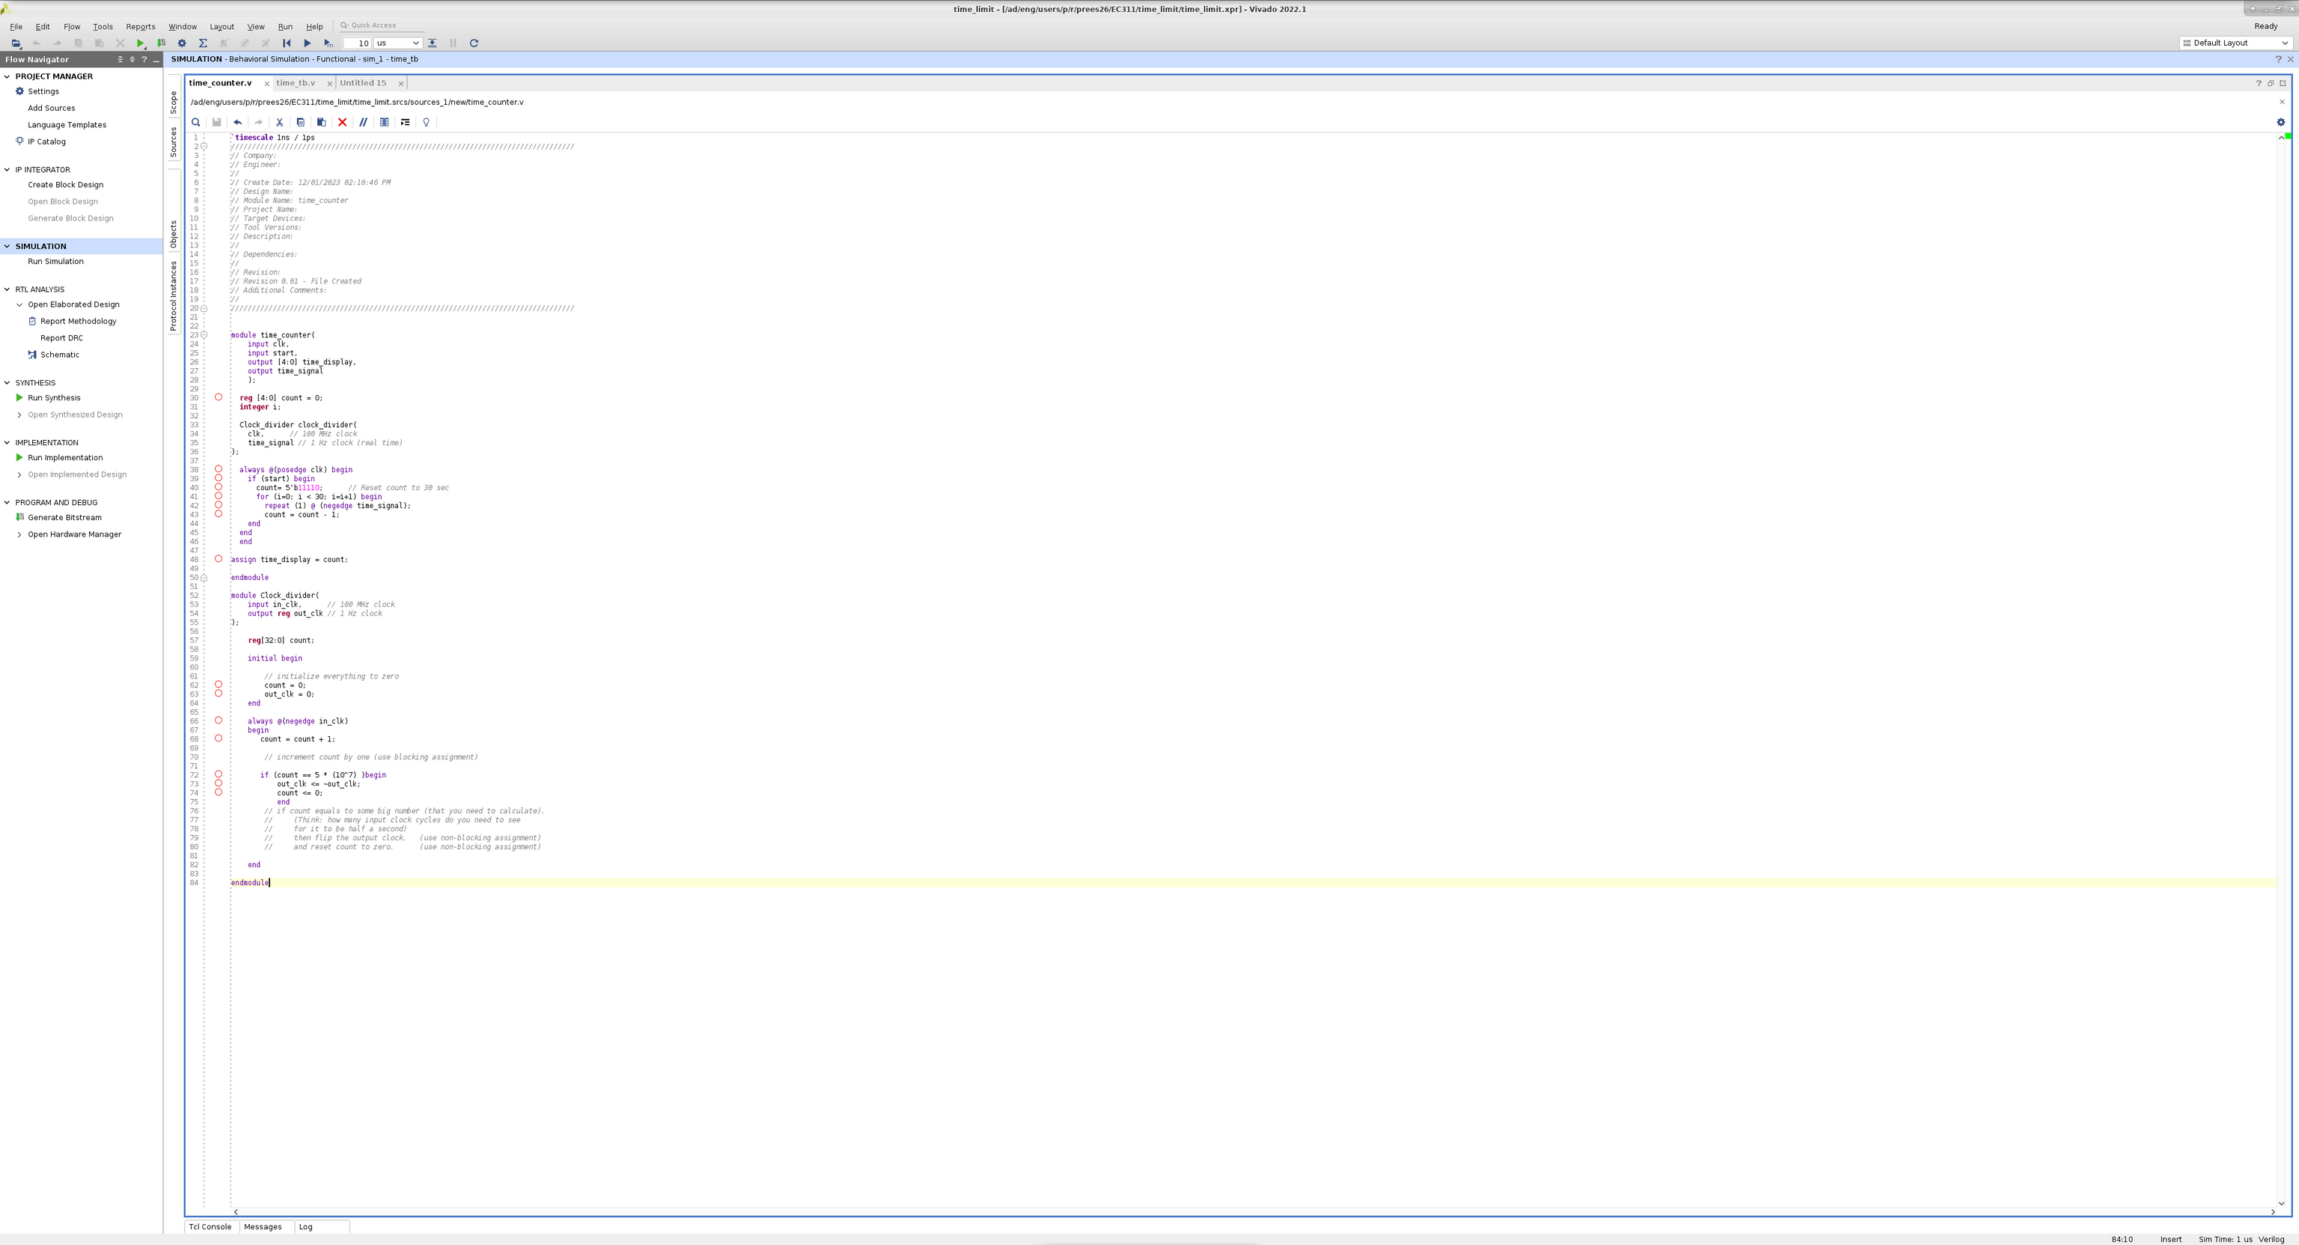
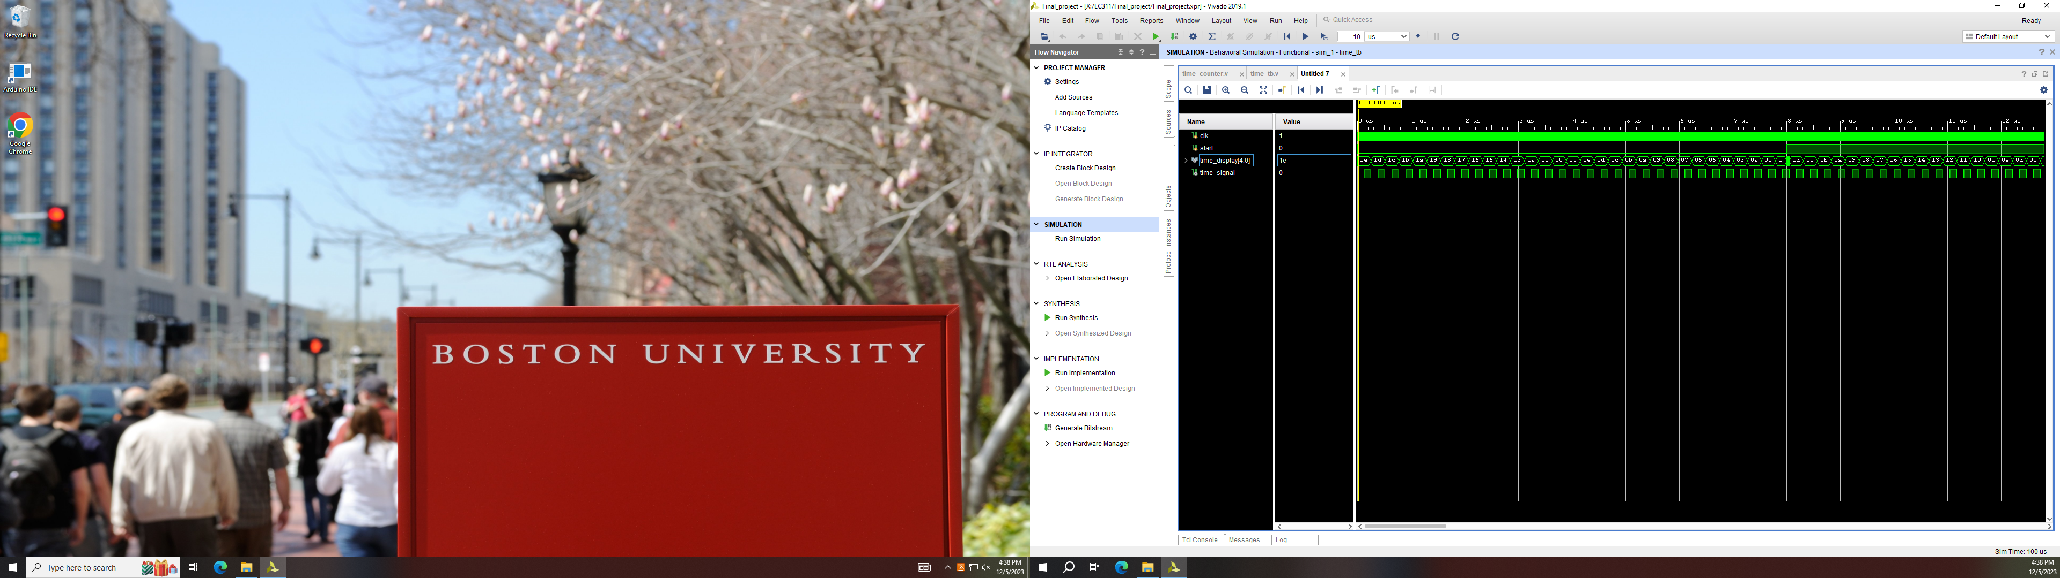
30 SECONDS TIMER
Time counter Module
If start, count down 30 sec
reset to 30 sec when return to first page

Slide 10




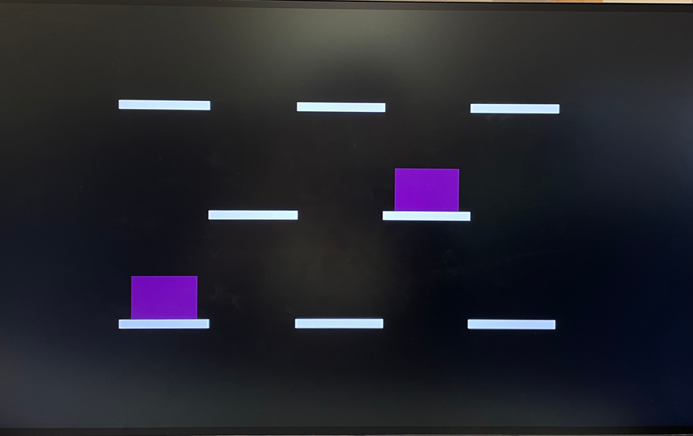

VGA DISPLAY
EXPECTATION
Start Page:
Select Difficulty levels:
EASY, Medium and hard
start Button
00:25
Game Page:
Holes
Moles Appearing
30 sec Time Countdown
ScoRe
REality
Result Page:
final score Result
Restart Button

Slide 11
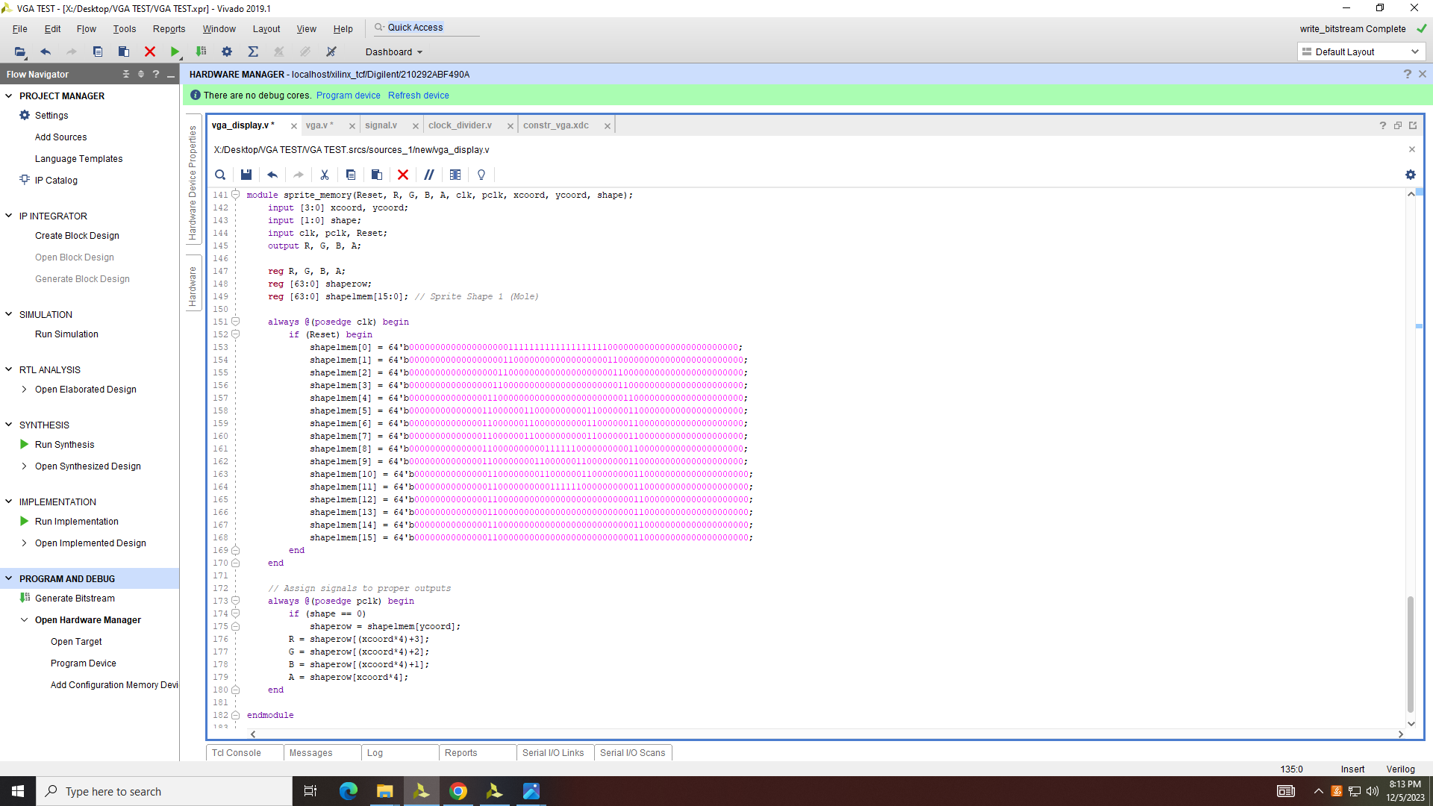
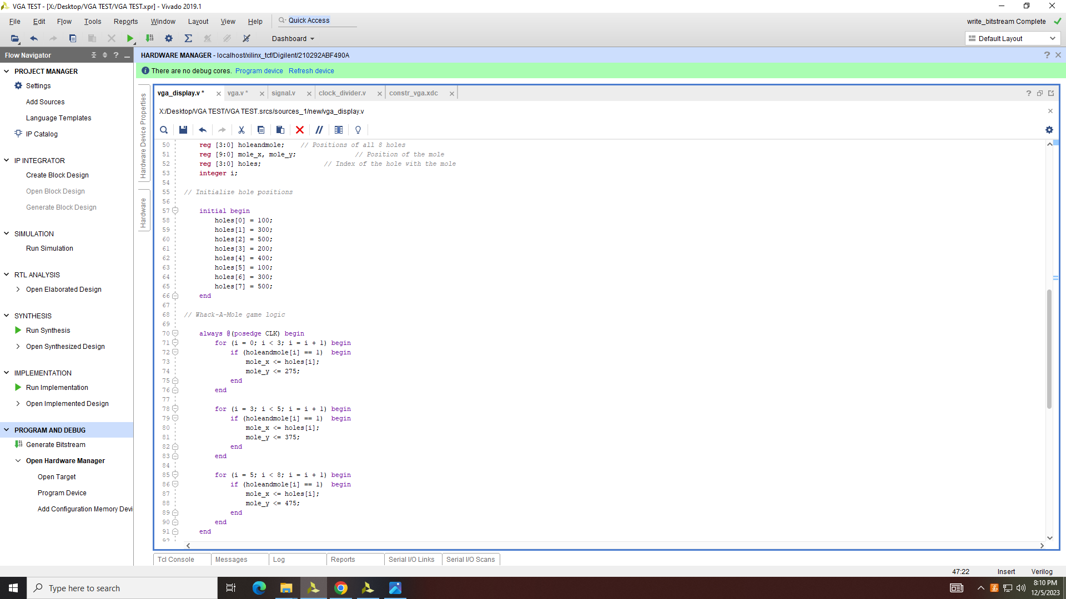



VGA CODE SNIPPET
MOLE Appearing on the holes
Example of the code indicating the exact coordinate where the mole will pop up by the loaction of the hole
MOLE
SPRITE
Find if that hole has a mole appearing or not
holeandmole = 10001001
THAT’S ME!
Set the mole to be at the position of the hole
the first hole has a mole

Slide 12
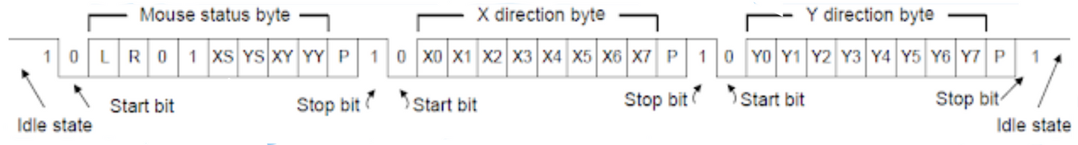
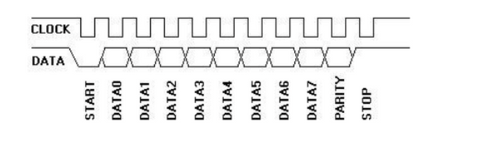
HIGHSCORE 2500
PLAYER 2
MOUSE TRACKING
tracking mouse movement through x and y coordinates and mouse clicks
communication between the mouse and the FPGA is done through a ps/2 interface
two signals - PS2_CLK and PS2_DAT are sent to the FPGA
The mouse writes on the data line on the rising edge of CLK and the host reads it on a falling edge

Slide 13
HIGHSCORE 2500
PLAYER 2
MOUSE TRACKING
CHALLENGE
POTENTIAL SOLUTIONS
keeping track of relative changes after each falling edge with a register and calculating the absolute coordinates
the x and y coordinates communicated through PS2_DAT line are relative coordinates
using the USB2 communication interface rather than the ps/2 interface

Slide 14


NO NAME
OUR SUCCESS
DISPLAY Holes and moles
on vga!
SET TIME LIMIT
Change difficulty
FInd whack-
a-mole code

Slide 15
01
07
12
TESTING ALL MODULES
THINGS
CReating module that can be played
both on keyboard and mouse.
TO
Pause phase
IMPROVE
Leaderboard

Slide 16






THANK YOU!
FOR LISTENING
GITHUB.COM/PRESTHAIBU/EC311-LOGIC-DESIGN-FINAL-PROJECT

